Slide 1
Socialism in China UNDERSTANDING PROPAGANDA POSTERS

Slide 2
ESSENTIAL QUESTIONS
How did Chinese leaders use propaganda posters to promote communism?
What messages and values underlie the images?
What can these posters tell us - and what can’t they?

Slide 3
History of Chinese Communism & Mao
THE LONG MARCH
THE GREAT LEAP FORWARD
1958-1962
THE CULTURAL REVOLUTION
1966-1976
1949
1964
1934
1958
1966
PEOPLE’S REPUBLIC OF CHINA ESTABLISHED UNDER THE LEADERSHIP OF THE CCP
THE LITTLE RED BOOK IS PUBLISHED

Slide 4
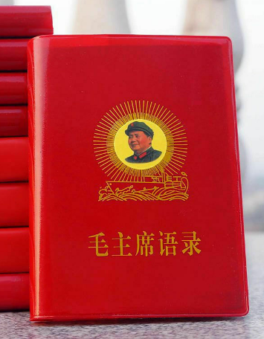
The Little Red Book
“How To” Guide
How to think and act as a good communist under Mao
Mao Speak/Thought
Meme-able phrases that proved you were with the “in-group”
Notes:
“a book of statements from speeches and writings by Mao Zedong, the former Chairman of the Chinese Communist Party, published from 1964 to about 1976 and widely distributed during the Cultural Revolution.”
"Every Communist must grasp the truth: Political power grows out of the barrel of a gun."

Slide 5
—Mao Tse Tung
"Talks at the Yenan Forum on Literature and Art" (May 1942), Selected Works, Vol. III, p. 86.
“In the world today all culture, all literature and art belong to definite classes and are geared to definite political lines. There is in fact no such thing as art for art's sake, art that stands above classes, art that is detached from or independent of politics. Proletarian literature and art are part of the whole proletarian revolutionary cause; they are, as Lenin said, cogs and wheels in the whole revolutionary machine.”

Slide 6
VISUAL PROPAGANDA VITAL
LOW LITERACY
MASS MOBILIZATION
UNITY

Slide 7
4 CHARACTERISTICS OF PROPAGANDA
STRONG EMOTIONS
SIMPLIFIES INFO
HOPES, FEARS & DREAMS
ATTACKS OPPONENTS

Slide 8
01
12 PROPAGANDA
TECHNIQUES
OCT 13 25
(Propaganda Analysis Bulletin, Institute for Propaganda Analysis (IPA), 1937-1942)

Slide 9
PROPAGANDA 1-6
BANDWAGON
GLITTERING GENERALITIES
TESTIMONIALS
NAME CALLING
TRANSFER
CARD STACKING

Slide 10
PROPAGANDA 7-12
LOADED WORDS
AD NAUSEAM
FEAR APPEALS
SCAPEGOATING
STEREOTYPING
SNOB APPEAL

Slide 11
02
EVALUATING PROPAGANDA

Slide 12
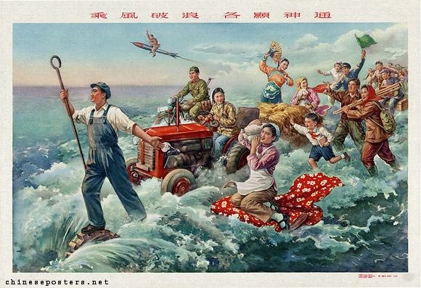
01.
“Braving the wind and the waves, each reveals their remarkable abilities”
1958
Notes:
The Chinese people were to go all out in a concerted effort to surpass England in 15 (or even less) years and to make the transition from socialism to communism at the same time, thereby leaving the Soviet Union far behind. That, at least, was the plan, which brought to an abrupt stop the earlier, more cautious attempts to sustain the speed of China’s recovery and further development by Five-Year Plans. The more radical members of the leadership tried to outdo each other with more and more unrealistic calls for "greater, faster, better, [and] cheaper" production. The characters for this call are emblazoned on the sails of the ship in the poster below. The poster also tries to impress on the population how all this will improve their welfare, as opposed to that of the Taiwanese, who are shown in the right-hand corner as suffering under the GMD-regime and the presence of Americans.

Slide 13
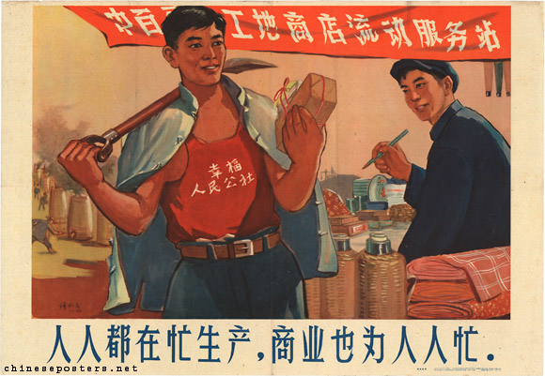
02.
“Everybody is fully occupied in production, the trade sector is also fully occupied for everybody,”
1958
Notes:
In the countryside, the various forms of rural cooperatives were merged into huge people’s communes. Rural life was completely collectivized, including mess halls where free food was supplied. Due to the excessive zeal of local officials, who were whipped up in the general atmosphere of enthusiasm while at the same time afraid to be branded as laggards, production figures that were unrealistic to begin with, were fixed higher and higher. Moreover, because everybody was involved in the battle to produce steel, labor power was lacking to bring in the harvests. If these amounts of food really could have been harvested, as the enthusiastic reports had promised, "communism was just around the corner", as the general belief in the autumn of 1958 seemed to be.

Slide 14
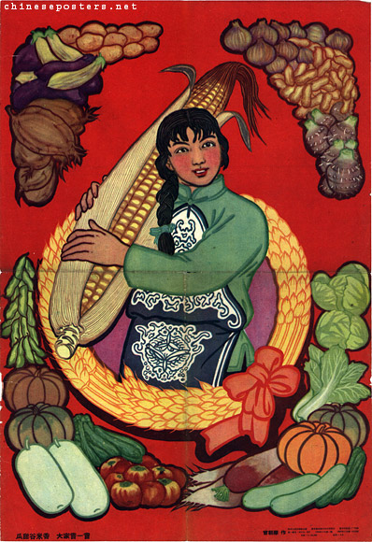
03.
The melons are sweet, grain and rice are fragrant, everybody tries the flavor
1958
Notes:
If the conditions in China turned from bad to worse from 1958 onwards, with the famine that resulted from the Great Leap as the nadir, how did the propaganda apparatus deal with this situation? It showed abundance.
One of the essential aspects of propaganda is that it should reflect reality, while at the same time providing an optimistic outlook of what lies ahead. The posters below, all published in 1960, belied what actually had been taking place and continued to provide a surreal picture of life.

Slide 15
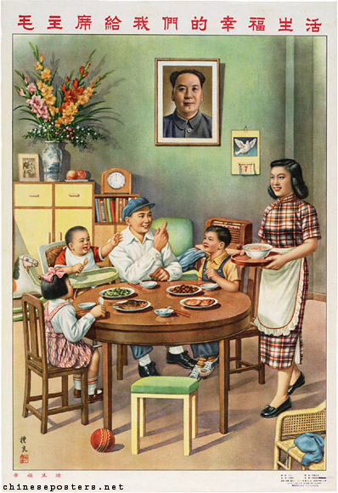
04.
Chairman Mao gives us a happy life
1954
Notes:
As the Cultural Revolution unfolded, Mao became a regular presence in every home, either in the form of his official portrait, or as a bust or other type of statue. Not having the Mao portrait on display indicated an apparent unwillingness to go with the revolutionary flow of the moment, or even a counter-revolutionary outlook, and refuted the central role Mao played not only in politics, but in the day-to-day affairs of the people as well. The formal portrait often occupied the central place on the family altar, or at least the spot where that altar had been located before it had been demolished by Red Guards in the early days of the Cultural Revolution. This added to the already god-like stature of Mao as it was created in propaganda posters.

Slide 16
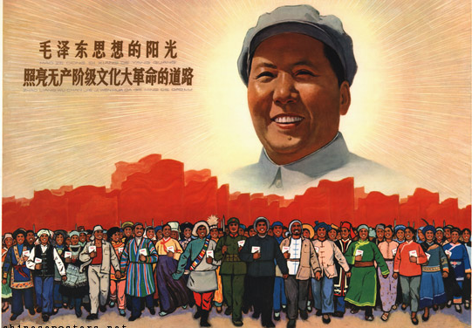
05.
The sunlight of Mao Zedong Thought illuminates the road of the Great Proletarian Cultural Revolution
1966
Notes:
As the the Great Leader, Mao came to dominate propaganda art of the first half of the Cultural Revolution. His image was considered more important than the occasion for which a particular work of propaganda art was designed: in a number of cases, identical posters dedicated to Mao were published in different years bearing different slogans, i.e., serving different propaganda causes. “Mao as the Sun”

Slide 17
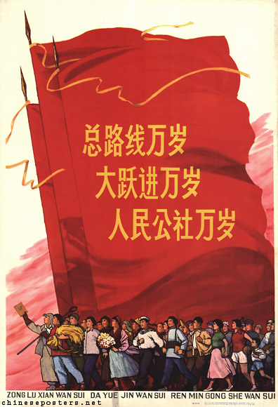
06.
Long live the General Line! Long live the Great Leap Forward! Long live the People’s Communes!
1964
Notes:
Moreover, as a result of the break-up of the relations with the Soviet Union, China was confronted with total economic collapse. The readjustment of the economy started in 1961, and took place under the leadership of Liu Shaoqi, Deng Xiaoping, Chen Yun and others. During the Seven Thousand Cadres Conference (七千人大会) in Beijing in 1962, when Party officials gathered from late January to early February, and discussed the disastrous famines of the Great Leap Forward that began in 1958, Mao made a self-criticism and then took a step back from power, withdrawing to Shanghai. From there, he plotted his return to the pinnacle of power, which resulted in the Great Proletarian Cultural Revolution.

Slide 18
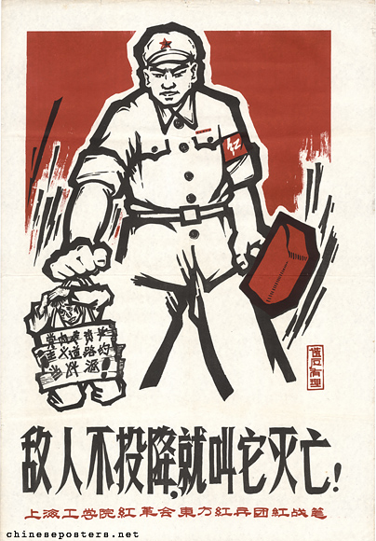
07.
If the enemy does not surrender, let him perish!
1967
Notes:
A big Red Guard with a big red hammer subdues a small man who is forced to wear a board with the text Capitalist roader holding power within the Party (党内走资本主义道路的当权派). The small text on the right, below the hammer: Rebellion is justified

Slide 19
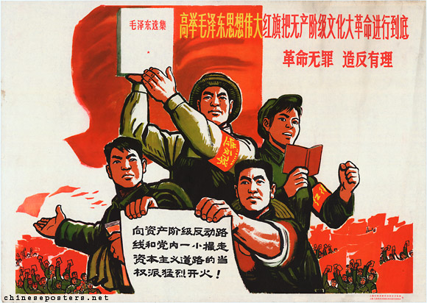
08.
Hold high the great red banner of Mao Zedong Thought to wage the Great Proletarian Cultural Revolution to the end--Revolution is no crime, to rebel is justified,
ca. 1966
Notes:
In the early 1960s, and during the first phase of the Cultural Revolution, the PLA played a major role in the popularization of the Quotations. According to Lin, "Everything that Mao Zedong says is the truth; every statement he utters is worth 10,000 sentences." The more wide-spread the study of the book, the more devastating the effects that were ascribed to it. In 1960, Mao Thought was seen as an arrow aimed at the target of revolution; by 1965, the Quotations were seen as a mighty "ideological weapon" in the struggle against imperialism, revisionism and dogmatism. One year later, Mao Thought had grown into a "spiritual atom bomb" of infinite power.

Slide 20
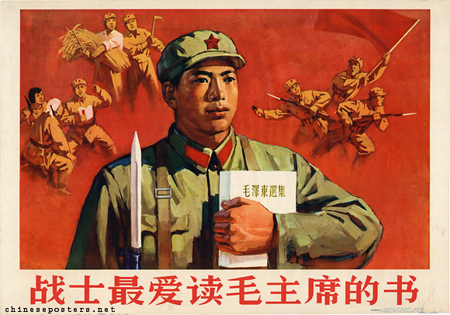
09.
Warriors love reading Chairman Mao's books most, 1966
Notes:
The PLA also supplied most of the behavioural models that embodied the "spirit of a screw" (luosiding jingshen 螺丝钉精神) by blindly following the instructions from the Party and/or superiors and attachment to the larger group. The best known of these were model soldiers as Lei Feng, Wang Jie, Dong Cunrui, and Ouyang Hai.

Slide 21
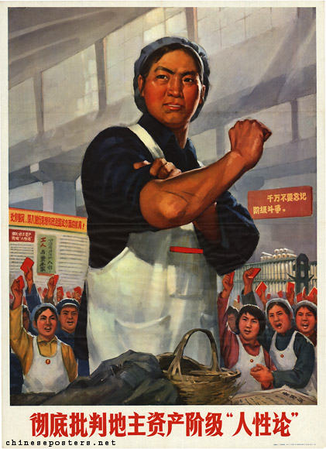
10.
Thoroughly criticize the ‘theory of human nature’ of the landlord and capitalist classes
1971
Notes:
As a result of the double agenda pertaining to the emancipation of women, their participation in production, made visible in posters, was seen as one of the basic keys to bring about their liberation. By the time of the Cultural Revolution, this trend of showing women taking on types of work generally associated with men was continued. In particular during the time when the movement to learn from the agricultural model commune of Dazhai was at its peak in the 1960s and 1970s, the muscular and energetic female team members, "imitation boys" (jia xiaozi) or "iron women" (tie nüren) working under commune leader Chen Yonggui, played an enormously influential function as role models for women. Iron girls inspired women to take on the most difficult and demanding tasks.While women who in preceding decades often were depicted while engaging in typically masculine pursuits, strong pressure was exerted on them in the 1980s to return to their traditional, more ‘feminine’ roles of servants/waitresses, mothers and child-rearers. Paralleling the changes in thinking among the leadership, the need was no longer felt in official art to urge women to break through the traditional assumptions of gender inferiority.

Slide 22
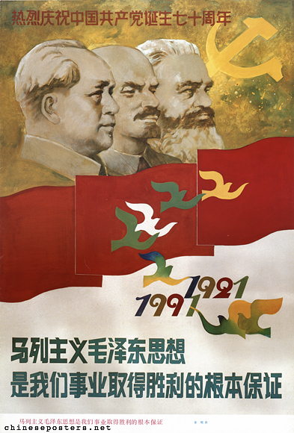
11.
Marxism-Leninism and Mao Zedong Thought are the fundamental guarantee for the victory of our cause
Warmly celebrate the 70th anniversary of the founding of the Communist Party of China.
1991

Slide 23
ESSENTIAL QUESTIONS
How did Chinese leaders use propaganda posters to promote communism?
What messages and values underlie the images?
What can these posters tell us - and what can’t they?

Slide 24
EXIT TICKET
MODERN AMERICAN PROPAGANDA:
Find an American ad (from the year 2000-present) that uses images to promote its message through one or more of the 12 techniques for propaganda. Print the ad to a PDF and attach it to this assignment.
Then write a paragraph (5-10 sentences) describing the propaganda, the technique it uses, and why it would be effective on the American population.

Slide 25
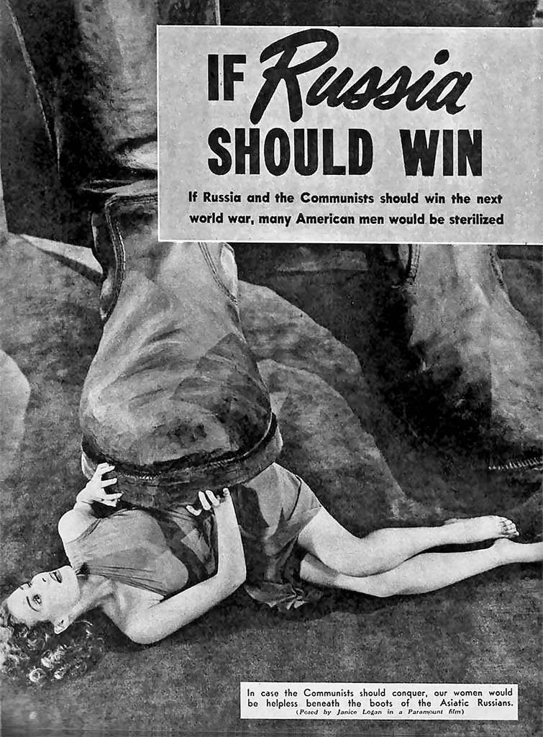
EXAMPLE:
American Film The Red Menace, 1949
Technique Used:
Fear Appeals
In this poster for the movie The Red Menace from 1949, a beautiful American woman is being crushed by the boot of an “Asiatic Russian.” The main caption reads “If Russia and the Communists should win the next world war, many America man would be sterilized.” This clearly uses the fear appeal propaganda technique. Its primary target would be American men, who would fear the inability to get married and have children. To a lesser extent, this propaganda technique would affect American women through the threat of violence by the communists. The Red Menace is a great example of the American Red Scare and the sensationalism that accompanied it.

